Slide 1


In 2023, 77.9% of brazilians are in debt,
the higher historic level ever registered.
Data from National Confederation of Commerce
of Goods, Services and Tourism (CNC)
Notes:
In the latest reports, Austria Household Debt reached 236 billion dollars in march this year.
United Arab Emirates’s Household Debt reached 457 billion dollars in april.
This is due to people spending impulsively, having poor financial education and, despite having high hopes and dreams of acquiring important things in life, may be hard to commit money and energy to this goal.
//Information came from CEIC Data.

Slide 2
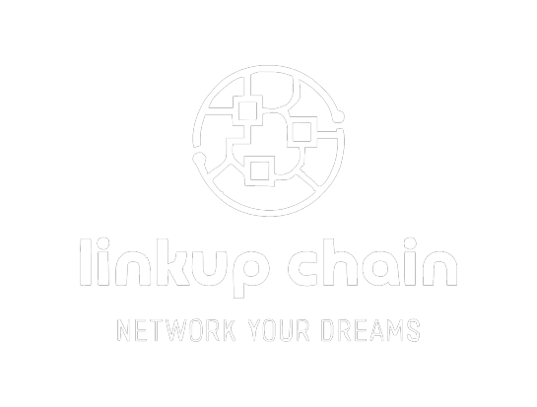
Notes:
To solve this issue, we developed a shared fund savings model: LinkUp Chain! An easy way to save money and make your dreams come true.

Slide 3




People share
a goal
Pay monthly until
total value
Each month, one
participant gets full value
Keep paying so
others can get there
Notes:
In this model, a group of people sharing the same kind of objective (for example, a car or a house) create a fund group and start working together to accomplish their goal.
Monthly, they pay up a fraction of the total price, locking their money with us, where it can be saved and invested, as to be returned to them in the end.
Starting from the third month, we have a lottery that selects one of the members to receive the full value of the asset in advance and purchase their brand new car or so desired home.
They, then, keep on paying the financed asset, while enjoying the dream come true, while other members can be selected on the following months as well.

Slide 4

WHAT IF THEY DON’T PAY?
Notes:
The question that comes up right away is: what if they don’t pay what they owe, right?
We have a few mechanics in place that might mitigate this risk.

Slide 5




Use ZEN Pass to
identify the user
Check credit score
beforehand
We own the asset until
the user finishes paying
Assets used as collateral
with finance compounds
Notes:
Using ZEN Pass, we can link the user’s personal information to the contract made with our platform.
With this identification being done, we are able to check if the user has a good enough credit score beforehand, checking if they are good payers or not.
When the person is selected to get the full prize, we contact them, get further info if needed and buy the asset for them in our possession. Once they finish paying the loan, we transfer the asset to the user’s possession and they rightfully own the thing.
An option to the user that prefers to not identify themselves is to allow them to offer funds as collateral to participate in the fund. The collateral value is only returned to the user if they finish paying what is owed to the fund.

Slide 6

WHY CHOOSE US?

Slide 7




Move away from
big banks and government control
Reduced fees and
lower interest rates
Transactions transparency
and audited balance sheet
Reduced bureaucracy
and simple process
Notes:
First of all, reduced bureaucracy and walk away from the big banks and eyes of the government.
We also have a reduced operational cost, which means, a reduced administration fee for the user, as well as lower interest rates.
The transactions made by our platform would have the transparency offered by the smart contracts, as well as the regular audited balance sheet that will tell customer how much we have, where and if we have enough liquidity to pay our users.

Slide 8
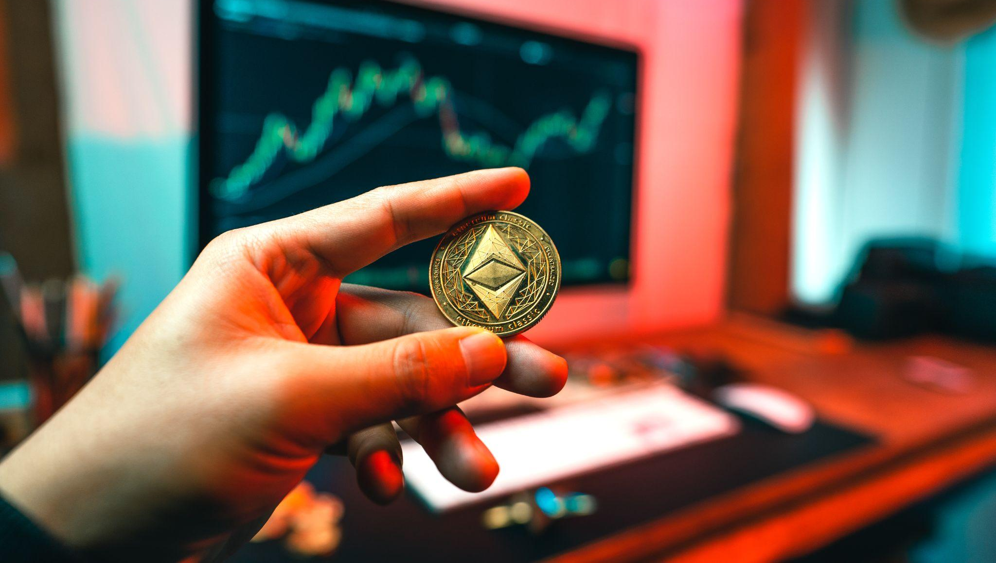
WHAT DO WE DO WITH THE MONEY?
Notes:
We will have, then, a huge potential in our hands. A great amount of funds that can be used to multiply the capital. While the participants will receive the value they saved corrected by inflation, any spread gained with our investing come to us as profit.
The operations will run like this: we will use the advantage of exchange to invest from countries with stronger coins to countries with cheaper currencies.
So, let’s look at some numbers.

Slide 9
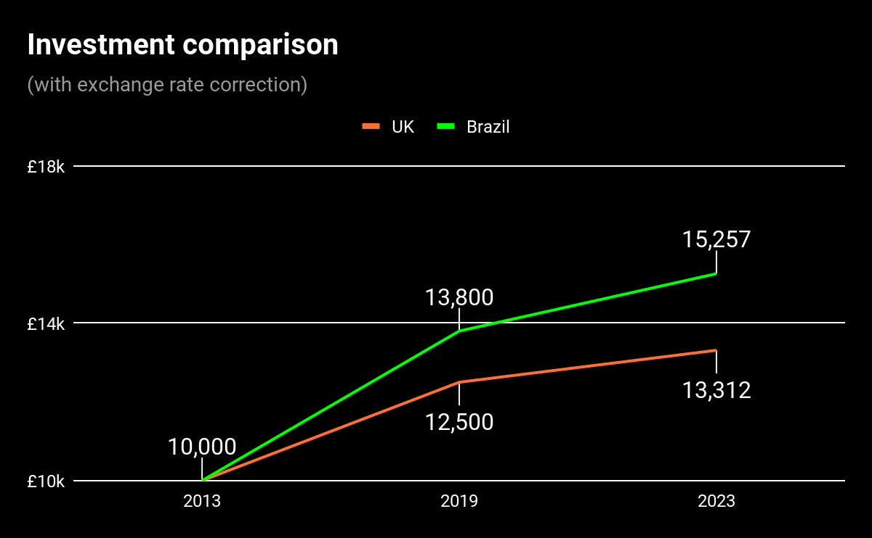
Notes:
In 2013, if a british citizen had invested 10.000 pounds in both Brazilian and British treasury, he would have amounted in 2019:
13.800 pounds investing in Brazil and 12.500 pounds investing in UK.
If he’d have kept this investment until 2022, he’d have £15257 in Brazil and £13.312 in UK.
First part, 52%, second part 63%

Slide 10
+52%
Notes:
In 2013, if a british citizen had invested 10.000 pounds in both Brazilian and British treasury, he would have amounted in 2019:
13.800 pounds investing in Brazil and 12.500 pounds investing in UK.
If he’d have kept this investment until 2022, he’d have £15257 in Brazil and £13.312 in UK.
First part, 52%, second part 63%

Slide 11
+63%
+52%
Notes:
In 2013, if a british citizen had invested 10.000 pounds in both Brazilian and British treasury, he would have amounted in 2019:
13.800 pounds investing in Brazil and 12.500 pounds investing in UK.
If he’d have kept this investment until 2022, he’d have £15257 in Brazil and £13.312 in UK.
First part, 52%, second part 63%

Slide 12
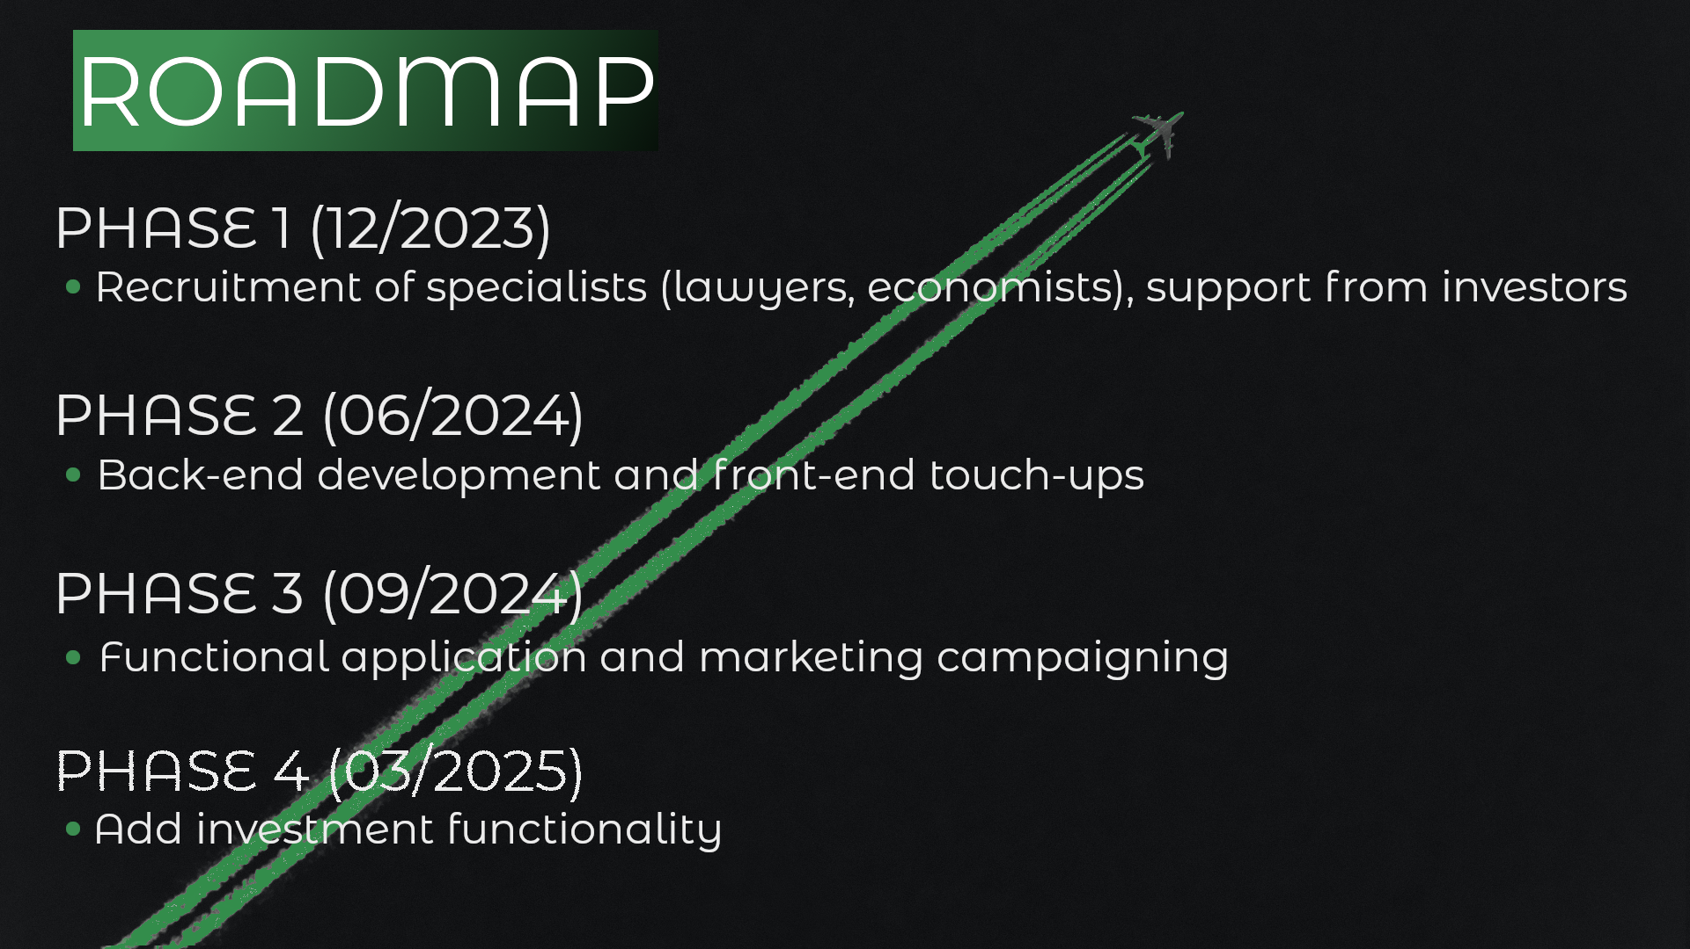
Notes:
What we expect with our project is that it is fully functional by the end of ___.
As future updates and features, we expect to implement ___ by ____, ___ by ____, ___ by ____.
And as we keep learning and connecting with more experienced professionals, we can improve the functionalities, features, investments and options for our customers.

Slide 13

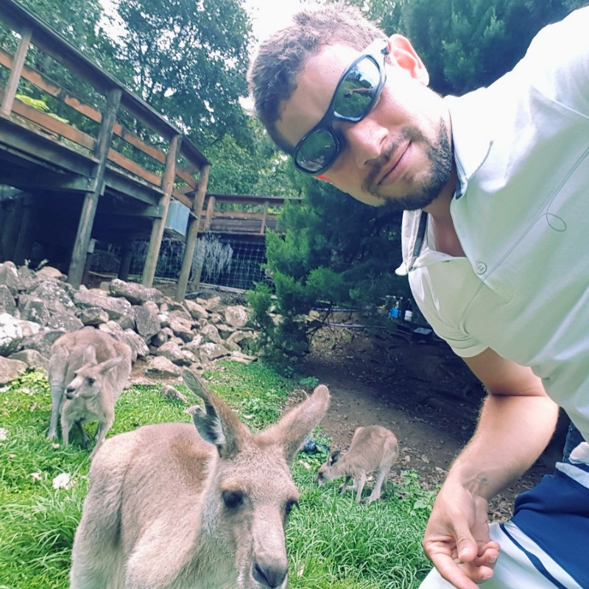
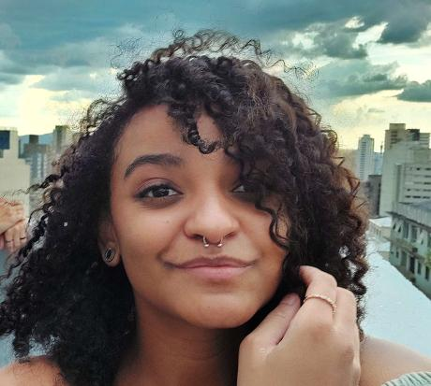

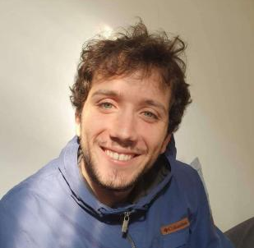
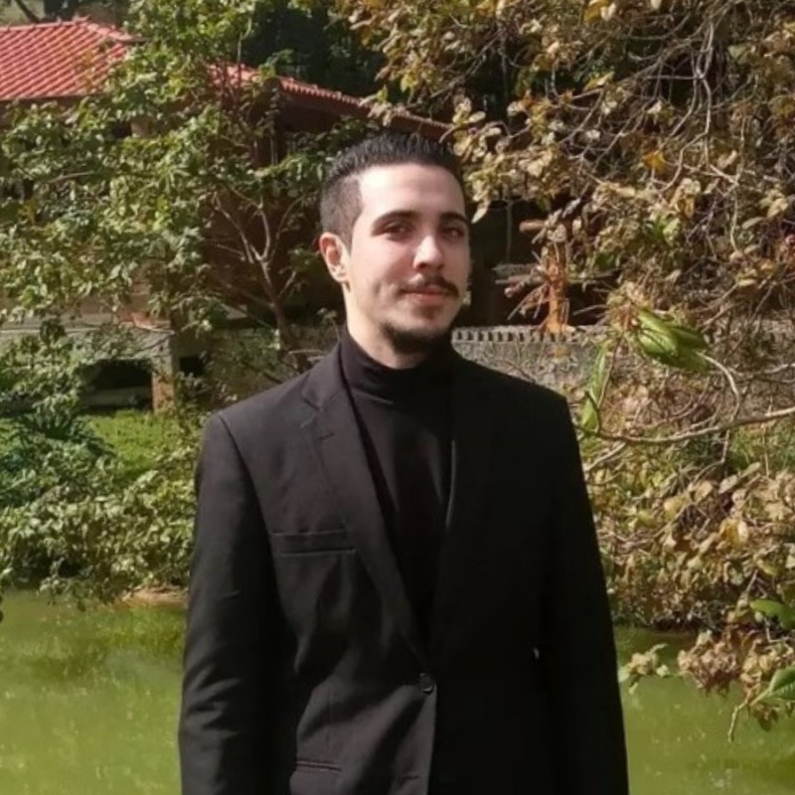
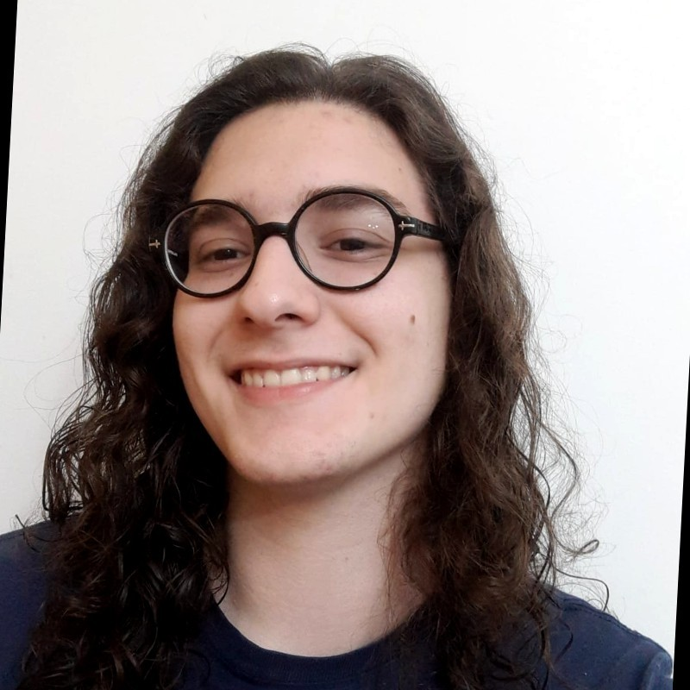
Atila
Costa
Juliany
Bernardo
Tales
Santos
Matheus
Pavoski
Willian
Portilho
João Victor
Mendes

